Slide 1
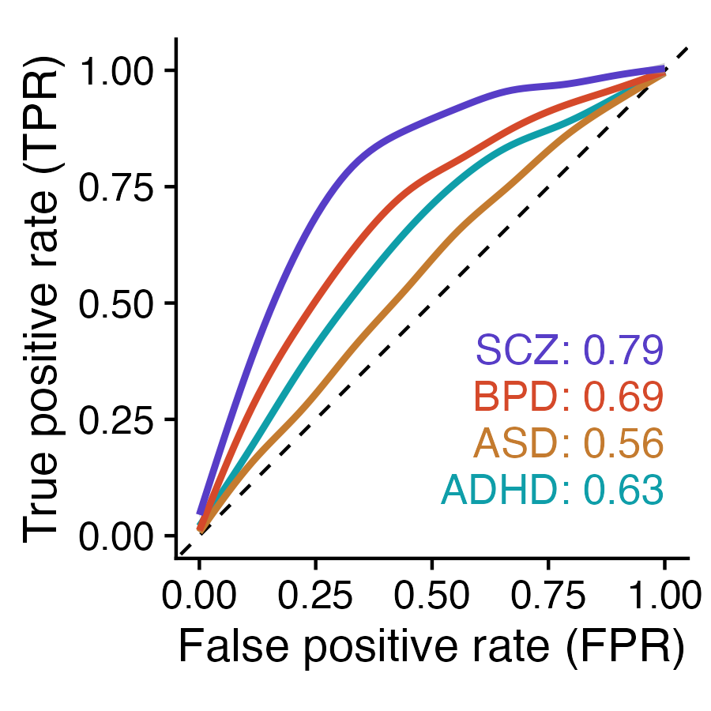


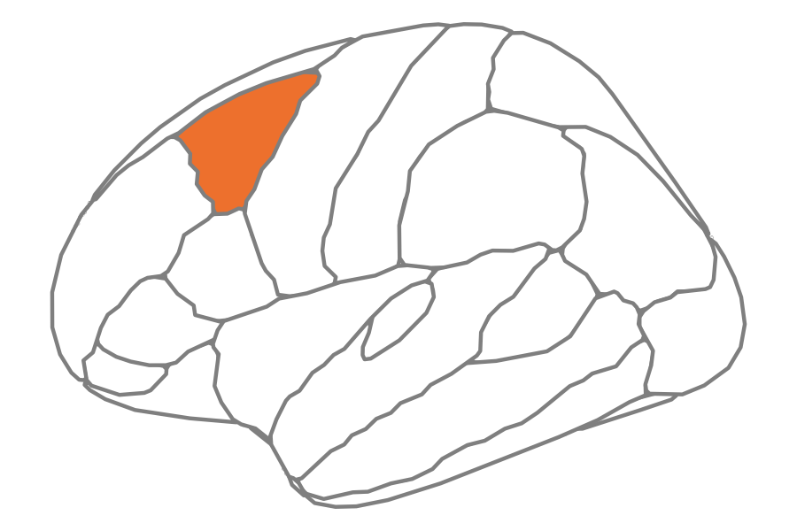
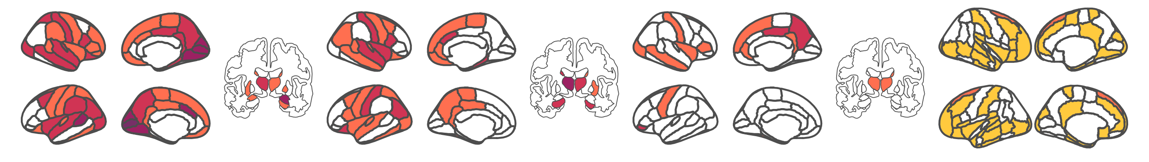
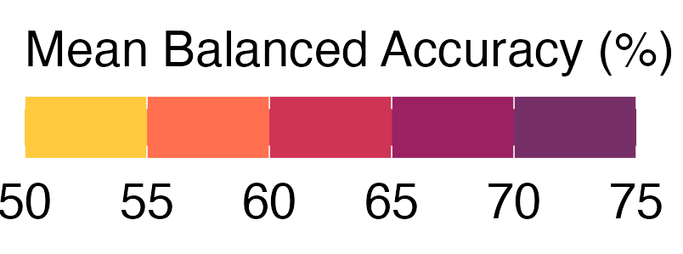
A
B
Features
Region 1
Region 1
Repeat for all N brain regions
Linear SVM
C
SCZ
BPD
ADHD
ASD
63 regions
44 regions
17 regions
27 regions
R
L
Notes:
Figure 2. Univariate time-series feature classification results.

Slide 2
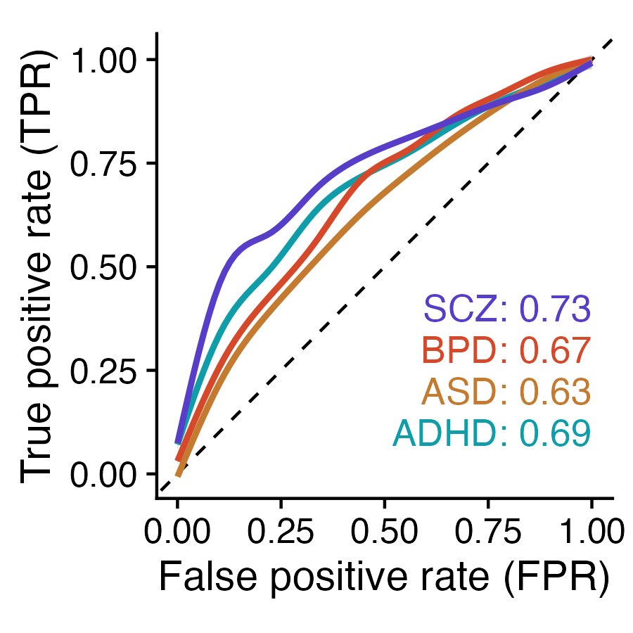
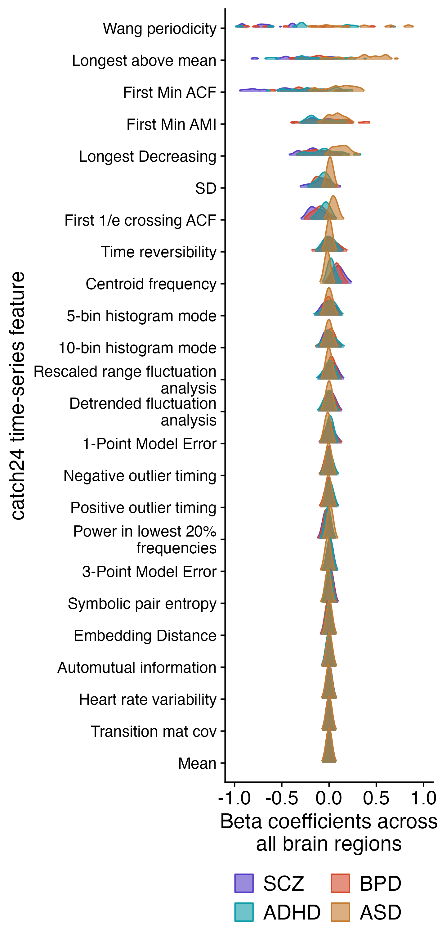
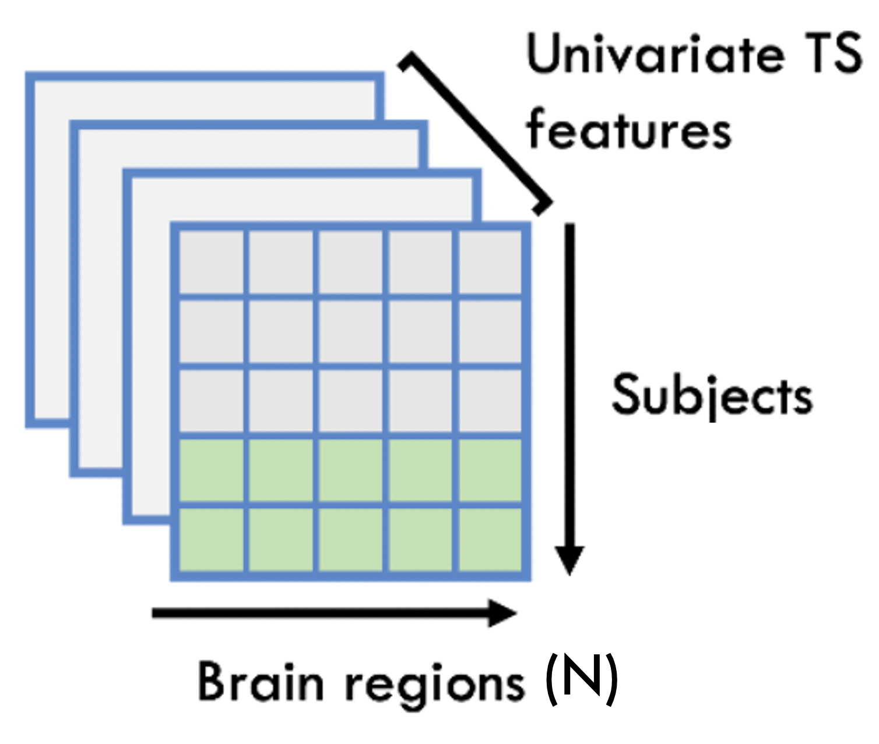
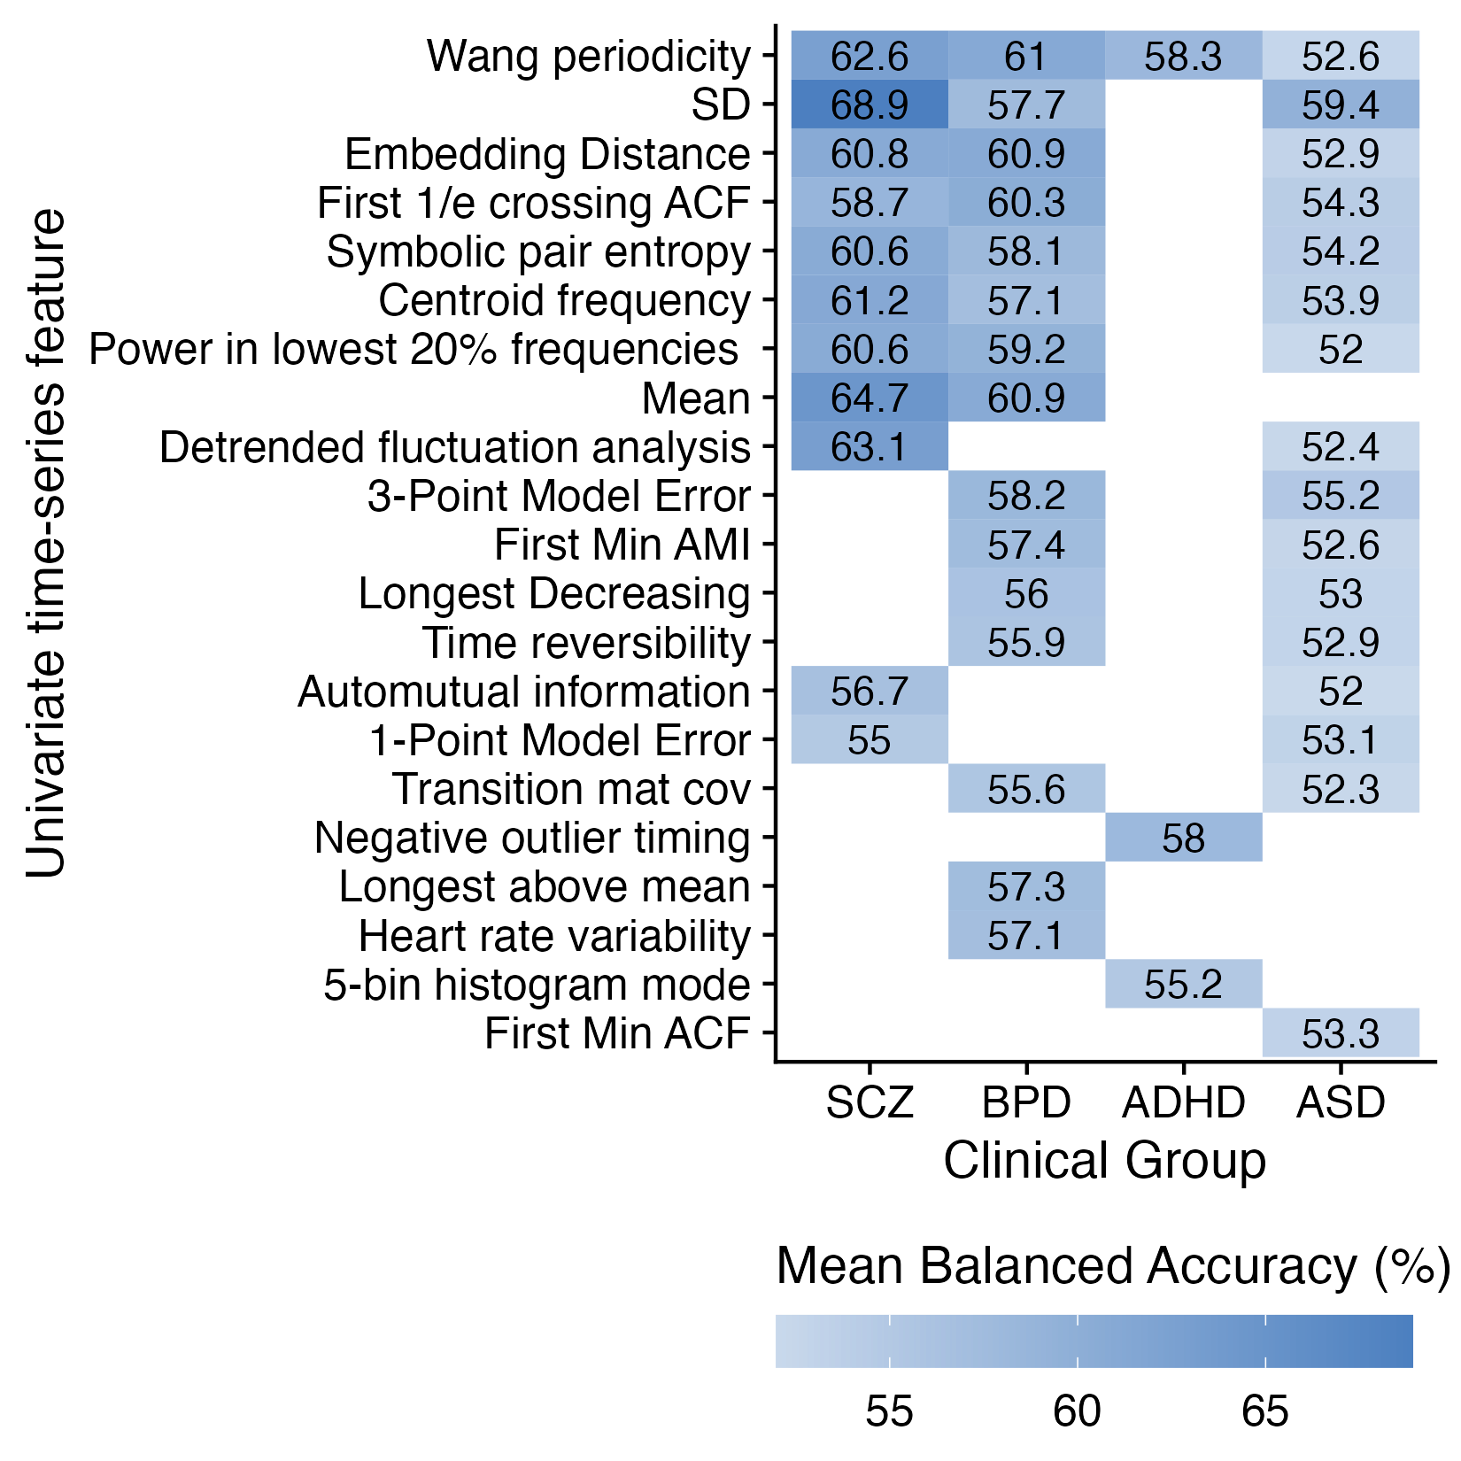
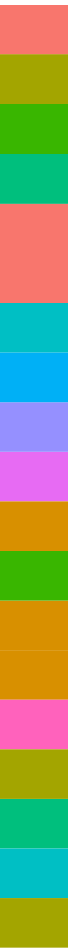
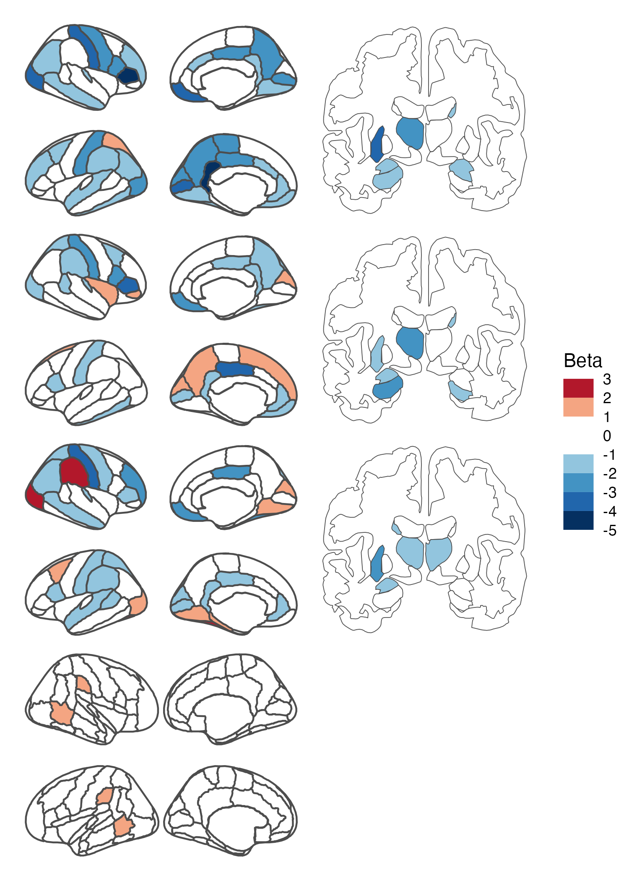
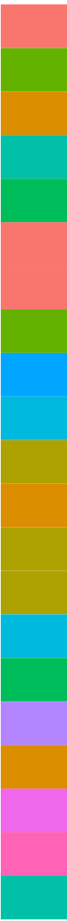
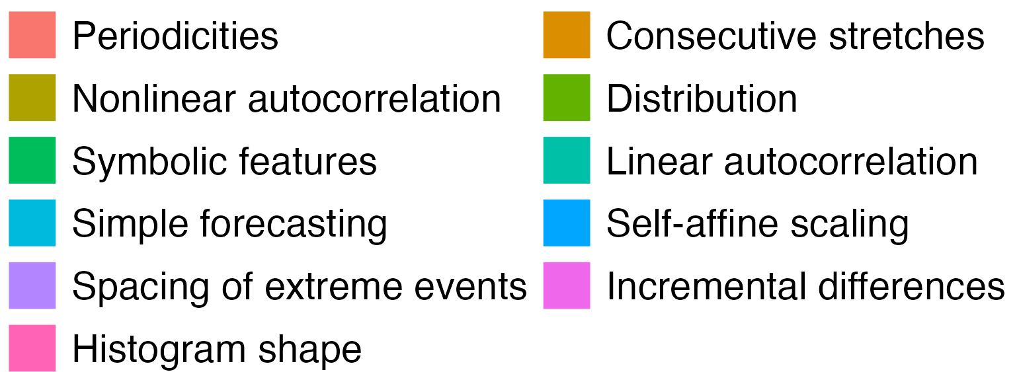
A
B
E
Features
Feature 1
Feature 1
Repeat for all 24 TS features
Linear SVM
C
Mean balanced accuracy (%)
D
SCZ
BPD
ADHD
ASD
Notes:
Figure 2. Univariate time-series feature classification results.

Slide 3
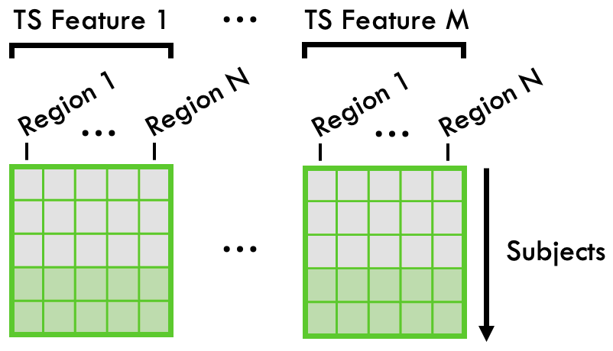
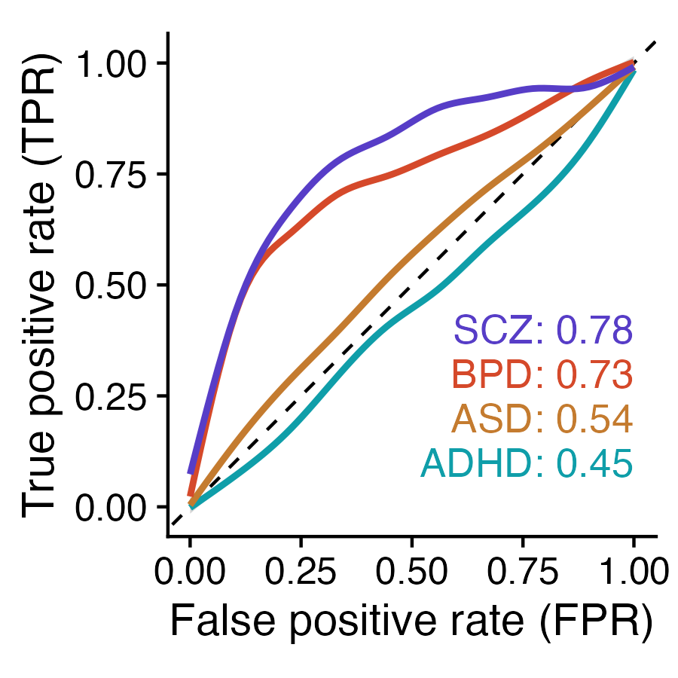
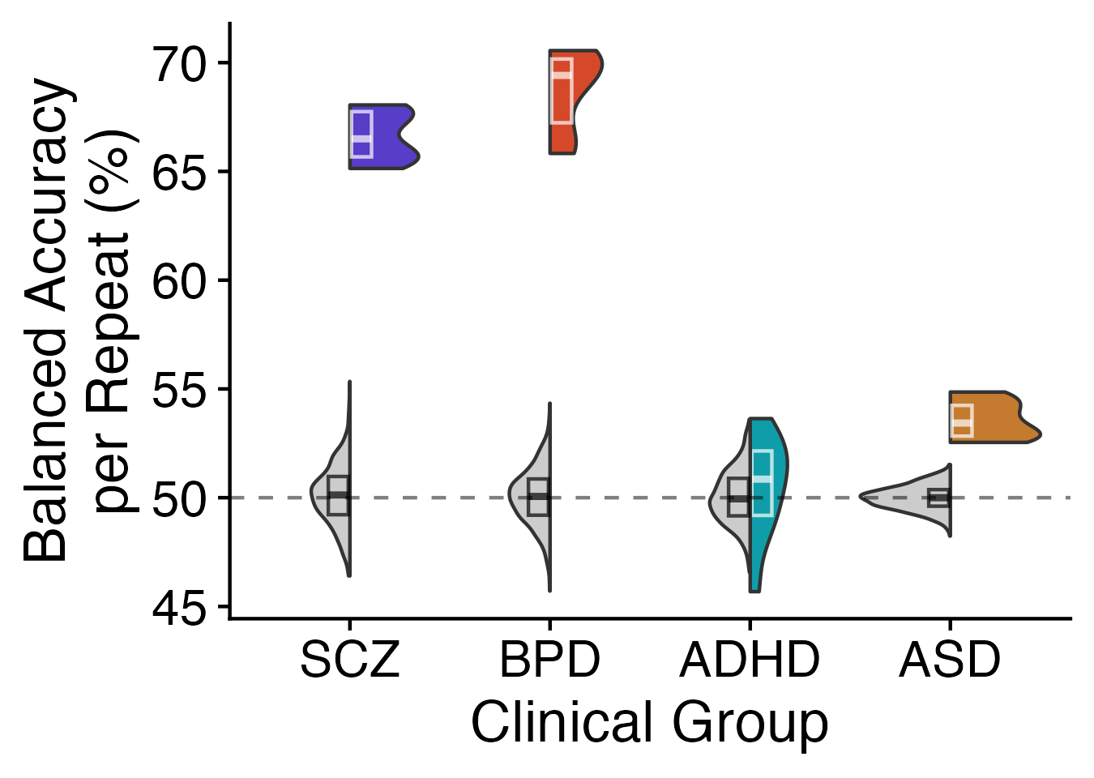
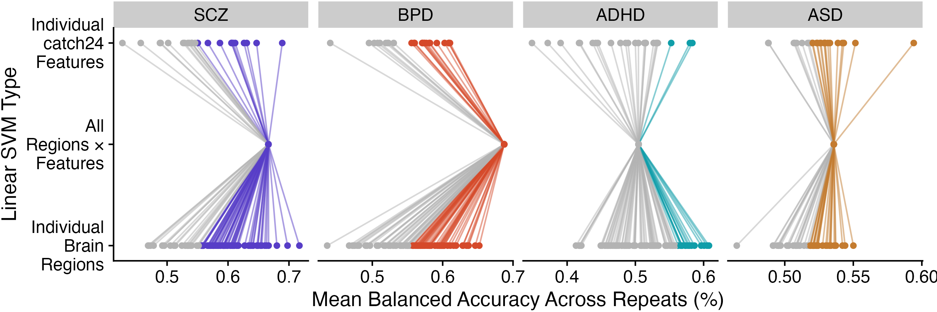
A
Features
B
Linear SVM
C
D
***
***
***
Notes:
Figure 2. Univariate time-series feature classification results.

Slide 4
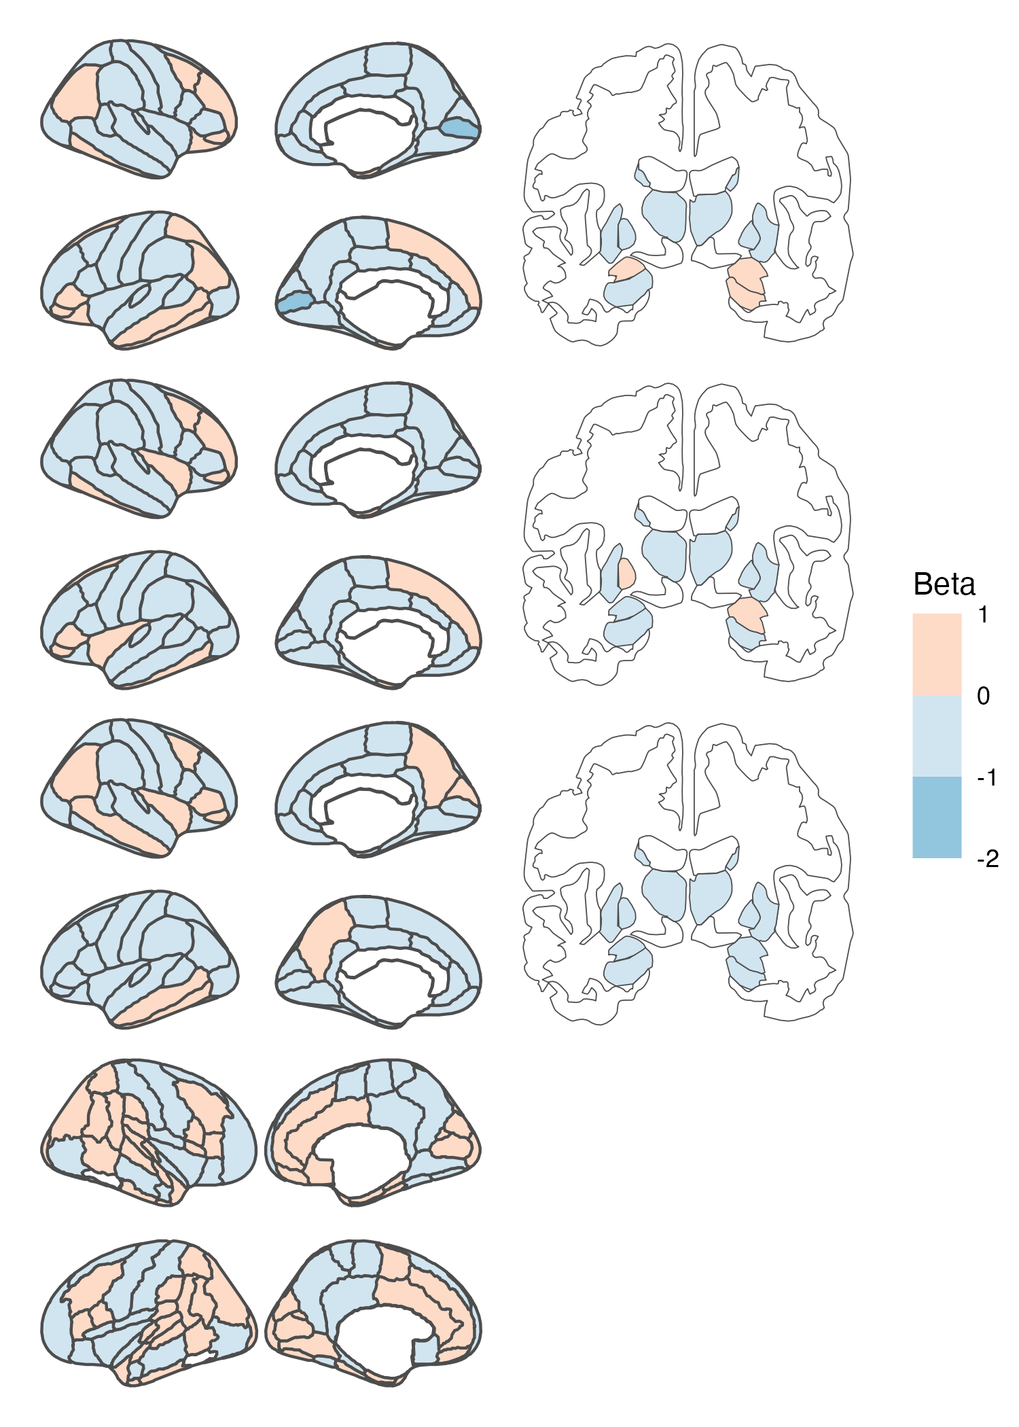
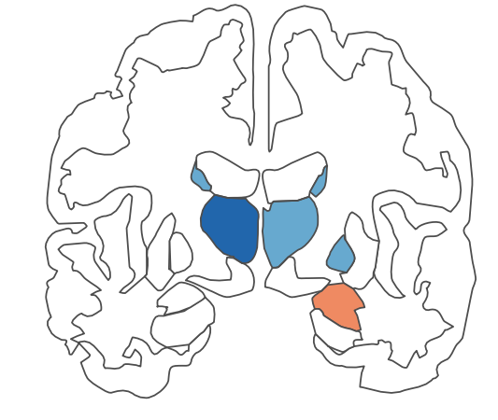
SCZ
BPD
ADHD
ASD
SD T-statistics
Notes:
Figure 2. Univariate time-series feature classification results.

Slide 5
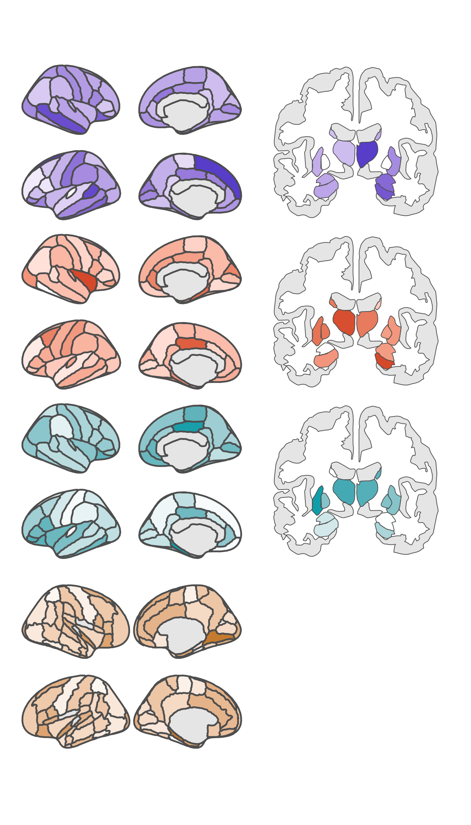
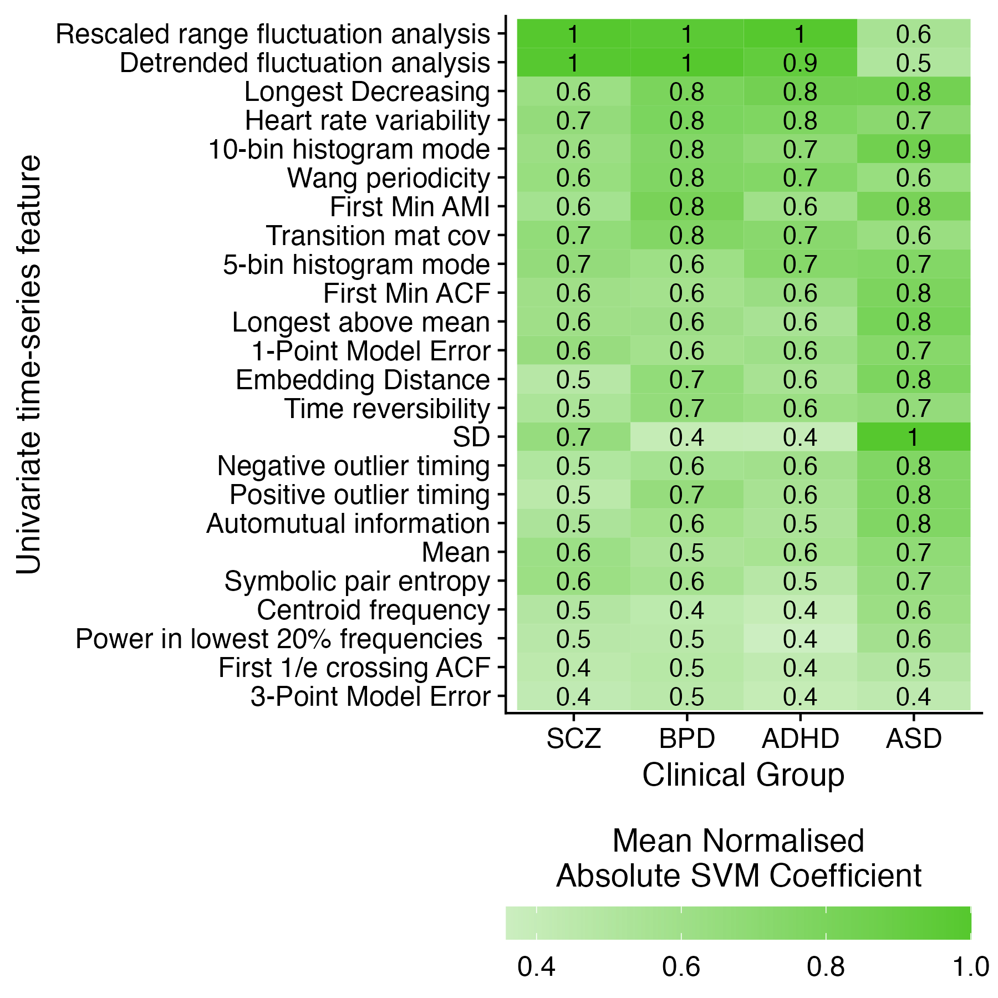
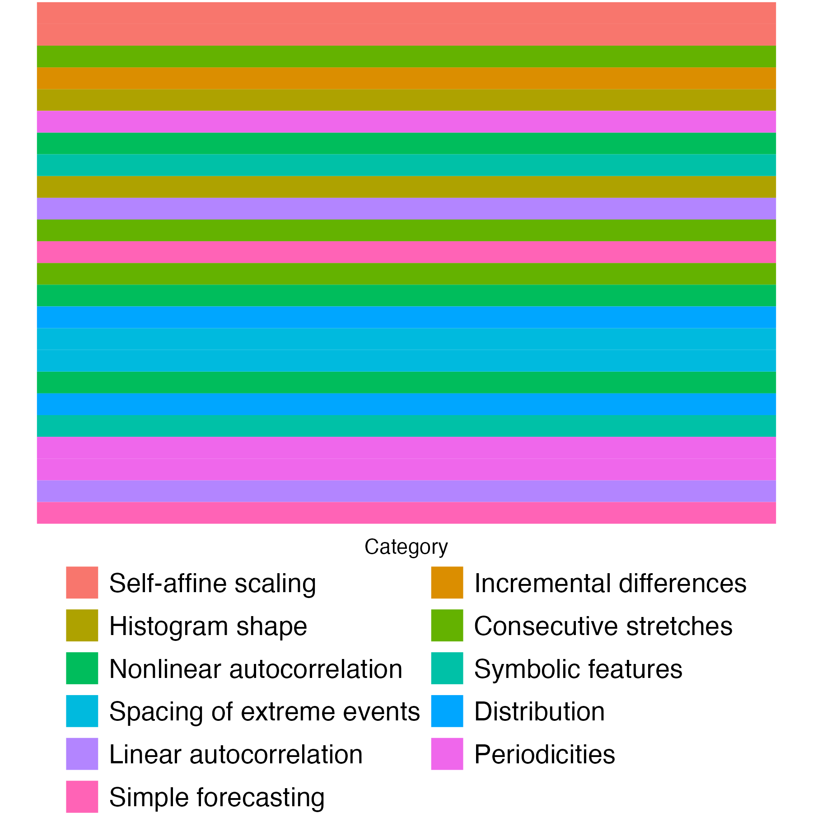
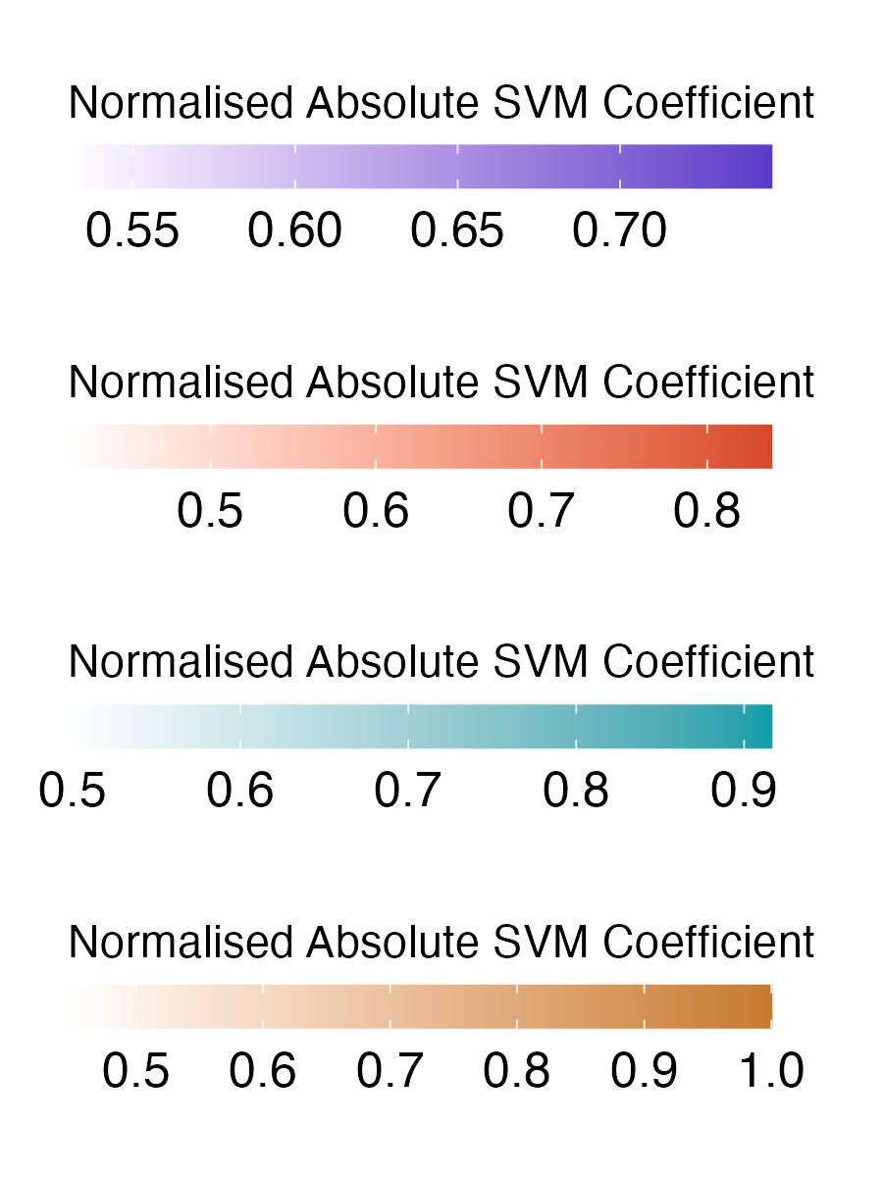
A
SCZ
BPD
B
ADHD
ASD

